Slide 1

Bill Splitter Application
The Bill Splitter Application is designed to streamline how teams handle shared costs, ensuring transparency and efficiency. It simplifies the process of adding expenses, dividing costs among members, and tracking settlements, fostering better financial accountability within teams.

Slide 2

Introduction
Efficient Expense Management
Cost Distribution
Users can add expenses, split costs among team members, and track settlements in real-time, making expense management seamless and accurate.
The Bill Splitter Application simplifies team expense management by automating calculations and eliminating disputes, ensuring a hassle-free experience.
Transparency and Accountability
With a structured approval system, the app ensures clear tracking of expenses, prevents unauthorized settlements, and promotes financial clarity within teams.

Slide 3




Key Features
Payment Verification
User Authentication
Team Management
Expense Splitting
Add expenses and split costs easily among team members.
Request and verify payments with status updates.
Secure authentication using JWT to protect user data.
Create and join teams for organized expense tracking.

Slide 4
Technology Stack
Frontend
Backend
Database & API
React.js: A JavaScript library for building user interfaces, known for its component-based architecture.
Spring Boot: A framework that simplifies building Java-based web applications.
MySQL: A relational database management system for storing application data.
JWT Authentication: JSON Web Token for secure authentication and authorization.
Tailwind CSS: A CSS framework for rapid UI development.
RESTful services: API design using Spring Boot for seamless communication.

Slide 5





User Flow
Authentication
Register/Login using JWT authentication for secure access.
Team Management
Create or Join a Team to start sharing expenses.
Expense Addition
Add Expenses and Assign Splits among team members.
Payment Request
Request Payments by Members involved in expense .
Verification & Settlement
Only the team creator can settle expenses while Other members can request settlement.

Slide 6
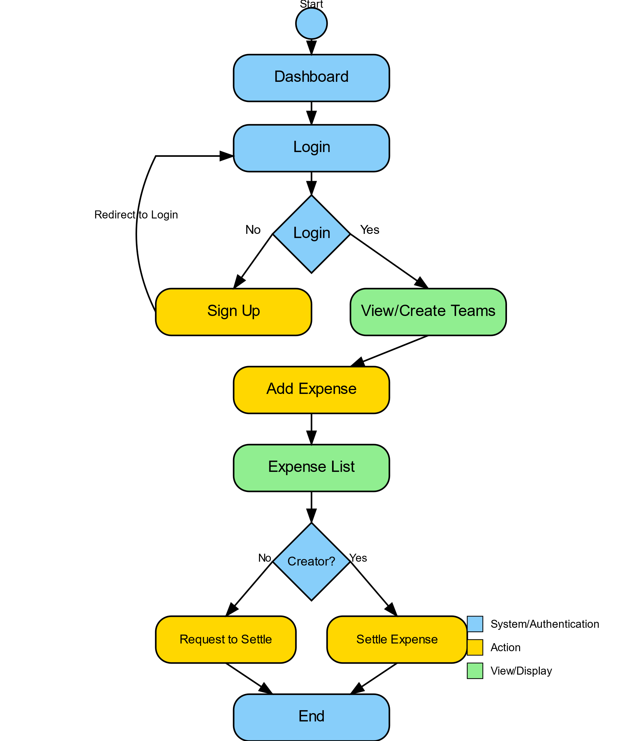

Activity Diagram
This activity diagram represents the structured workflow of the Bill Splitter Application, ensuring a seamless user experience. The process starts with user authentication, where users must log in or sign up to access the dashboard. Once logged in, they can create a team, invite members, or join existing teams. Within a team, users can add expenses, view the expense list, and track payments. Only the team creator can settle expenses, while other members can request settlements. The system maintains a record of all transactions, ensuring transparency and efficient expense management

Slide 7

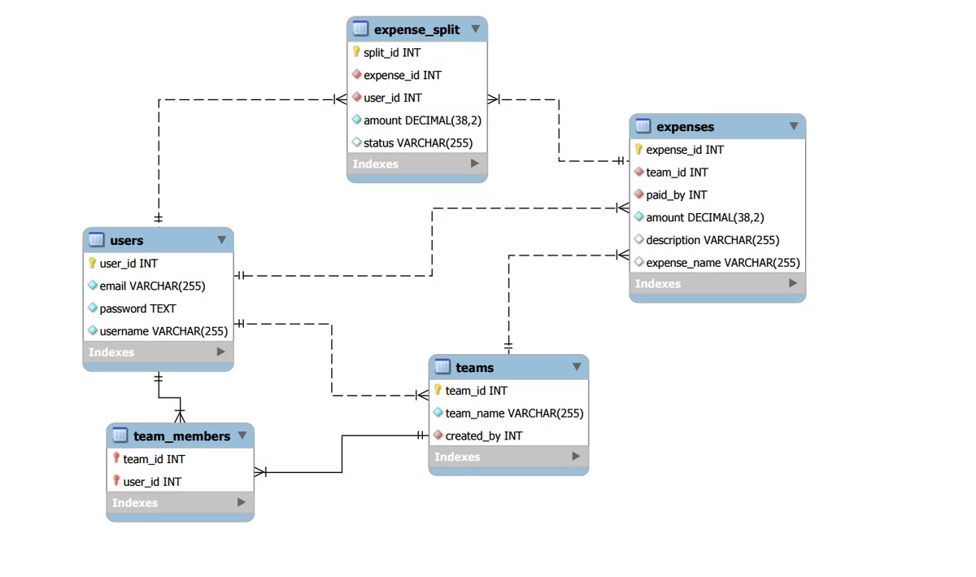
Database Diagram
The database diagram visualizes the structure and relationships between key tables in the Bill Splitter Application, ensuring organized and efficient data management. It outlines how users, teams, and expenses are interconnected, maintaining data integrity and enabling smooth operations. The Users table stores user details and authentication data, linking to the Teams table, where team information and memberships are managed. The Expenses table records shared costs, associating each expense with a specific team and its contributing members. The diagram clearly defines how expenses are split, tracked, and settled, ensuring transparency and accurate financial management within teams.

Slide 8
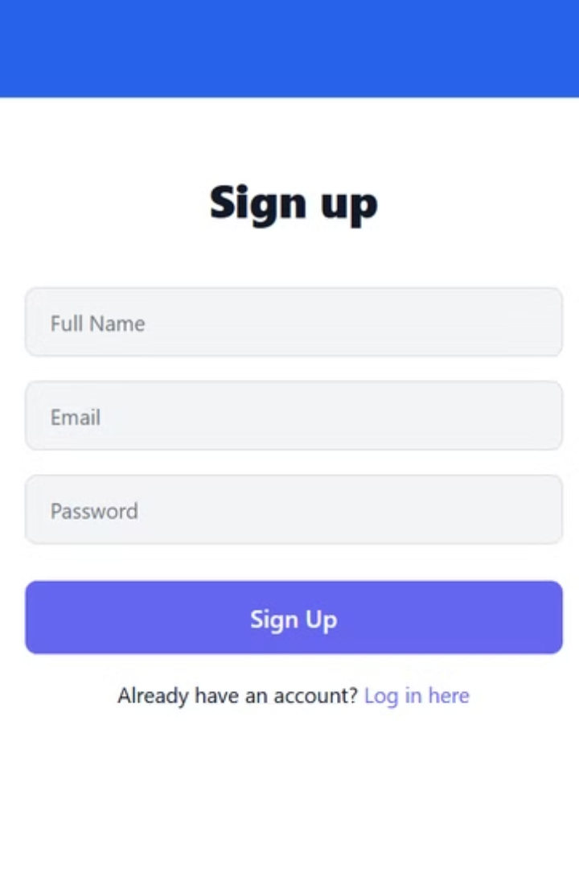
Sign Up
The sign-up page provides a simple and user-friendly interface, allowing new users to create an account effortlessly. By entering basic details such as name, email, and password, users can quickly register and gain access to the application.

Slide 9
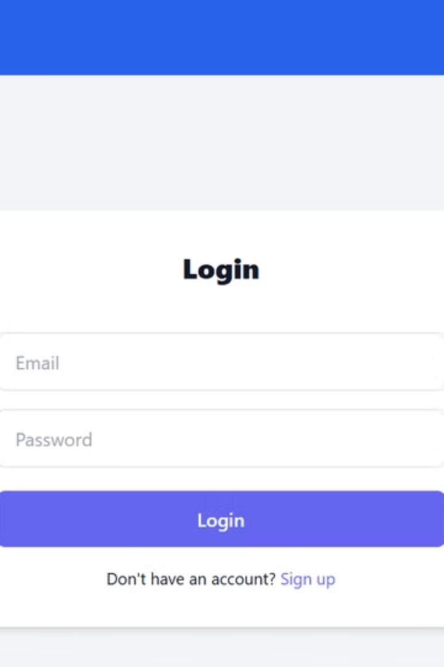
Login Page
The login page provides a simple and secure way for users to access their accounts. With a clean design and clear input fields, users can quickly enter their credentials and log in without hassle. Security is a priority, ensuring that authentication is handled safely while maintaining a seamless user experience. The straightforward process minimizes delays, allowing users to access their teams and manage expenses efficiently.

Slide 10

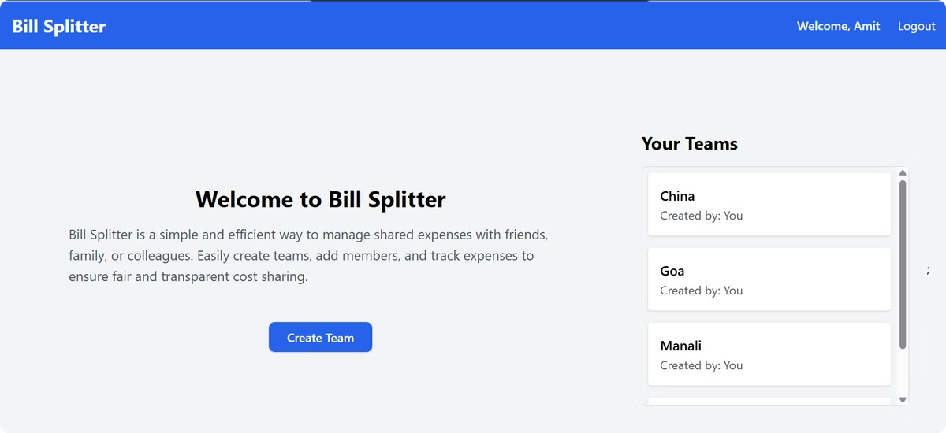
Team List
The Team List feature allows users to view and manage all their teams in one place. It ensures a smooth expense-tracking process by keeping everything organized and accessible

Slide 11
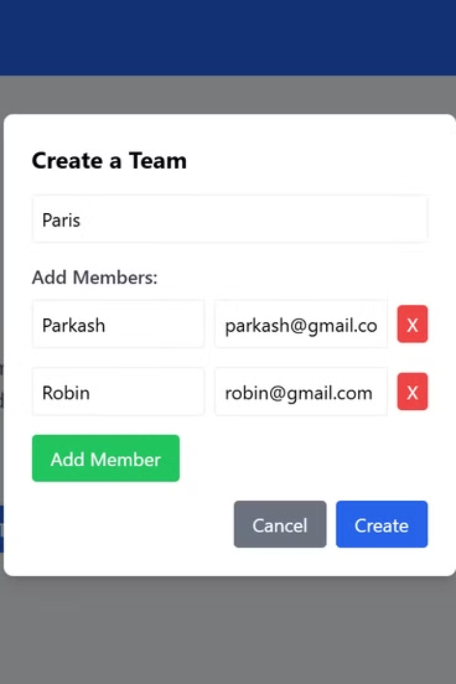
Create Your Team
Seamless Setup
Customizable Settings
Easily create a team from the dashboard after logging in. Our simple interface allows users to enter a team name and add members quickly, making the setup process hassle-free.
Define team-specific expense and manage settlement permissions, ensuring that only the team creator can settle expenses while others can request settlements.

Slide 12

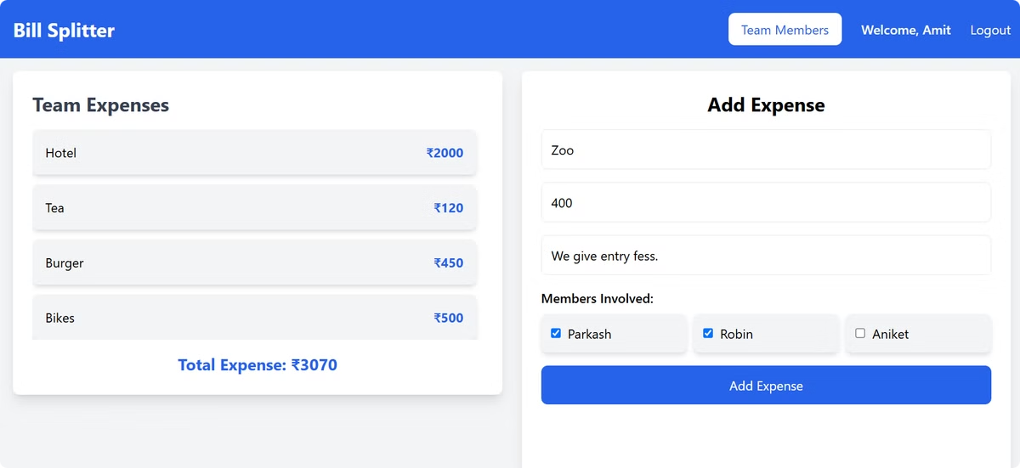
Adding Expense
1
Quick & Easy Entry
Effortlessly add expenses within a team by specifying the amount, description, and members involved. Our intuitive interface ensures a seamless process.
2
Flexible Expense Splitting
Choose how to split expenses – equally among all members or customize shares based on contributions.
3
Transparent Tracking
View a detailed list of all expenses within the team, ensuring clarity on who paid, who owes, and pending settlements

Slide 13
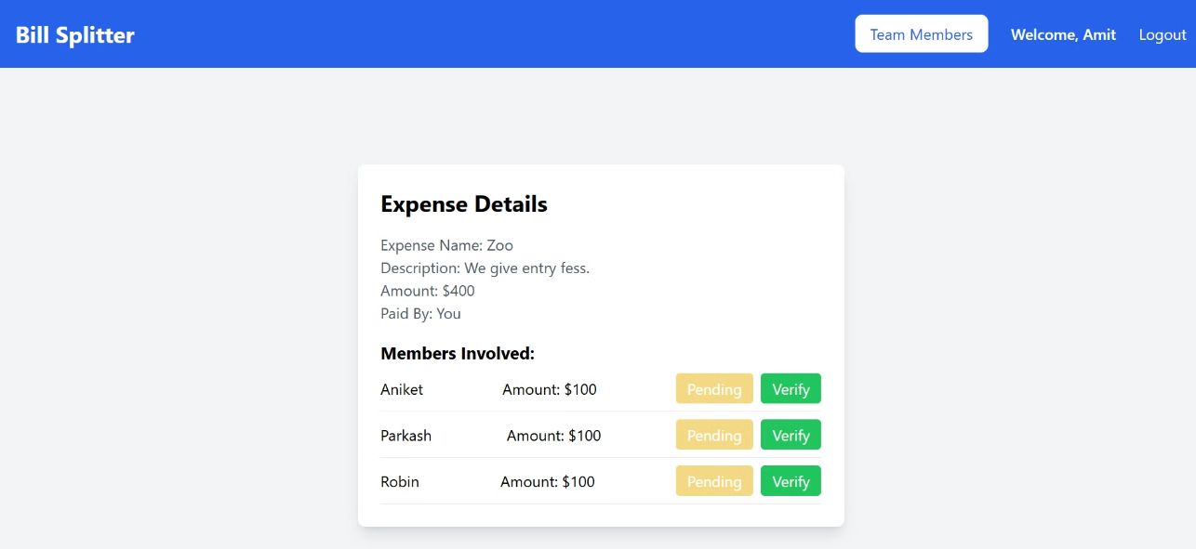
Detailed Expense Insights
Comprehensive Overview
Get a clear view of all team expenses, including who paid, who owes, and the amount split among members.
Track Pending & Settled Expenses
Easily monitor pending payments and settled transactions to maintain financial transparency within the team.

Slide 14


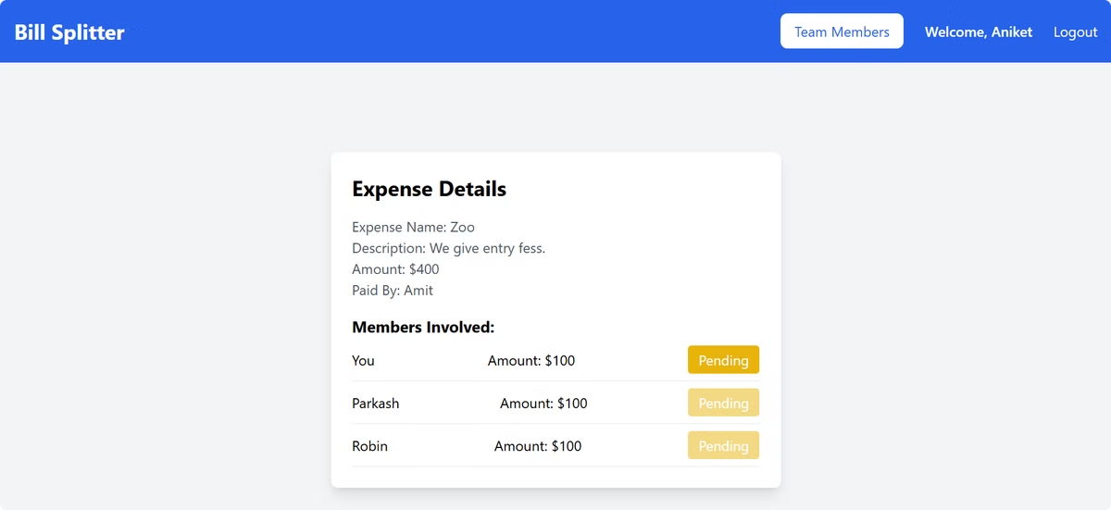



Streamlined Approval Workflows
Expense Submission
Users can add expenses by specifying the amount, description, and selecting involved members. Receipts or additional details can be attached for better tracking.
Review Process
The team creator reviews all submitted expenses to ensure accuracy before approving settlements.
Approval or Rejection
Only the team creator can approve or reject settlement requests, while other members can request settlements.
Tracking
All submitted expenses, pending requests, and settled amounts are logged, providing a detailed expense history

Slide 15

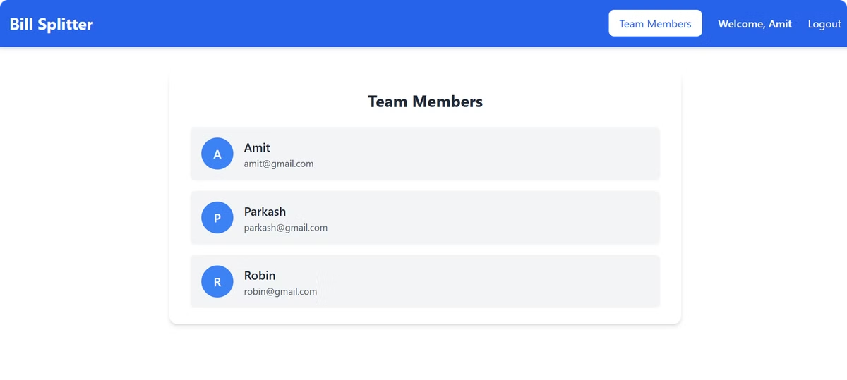
Team Members
The team members section displays a list of all members in a team, showing only their name and email. Users can view who is part of the team but cannot edit or manage other members. This ensures transparency while keeping the focus on expense tracking and management.

Slide 16

Thank You!
Thank you for taking the time to explore our team expense management app. We are confident that our solution will streamline your expense tracking process, improve transparency, and save you valuable time.

